Slide 1
Predicting Health Care Cost
IST 687
Yashanjali Yashwant Chavan
Immanuel Odarteifio
Matthew Penn
Abirami Rajalingam
Sahil Rajendra Wani

Slide 2
Project Objectives
To predict how much customers will pay for healthcare.
To find what factors contribute to a high healthcare cost.
Provide actionable insights into how to reduce customer costs.

Slide 3
TABLE OF CONTENTS
Data Analysis & insights
01
Data Description
02
03
Data Modeling and Trends
04
Conclusion and Recommendation

Slide 4
Data Description
01

Slide 5
Health Care
Data
13 Columns
7582 Rows
Source: https://intro-datascience.s3.us-east-2.amazonaws.com/HMO_data.csv
Mostly categorical data

Slide 6
BUSINESS QUESTIONS
Is there a disparity between gender and the cost of healthcare?
Do older people, who are more prone to hospitalization, have a large healthcare cost?
What's the mean cost per BMI?
Does a combination of high BMI & hypertension contribute to expensive healthcare?

Slide 7
Data Analysis & Insights
02

Slide 8
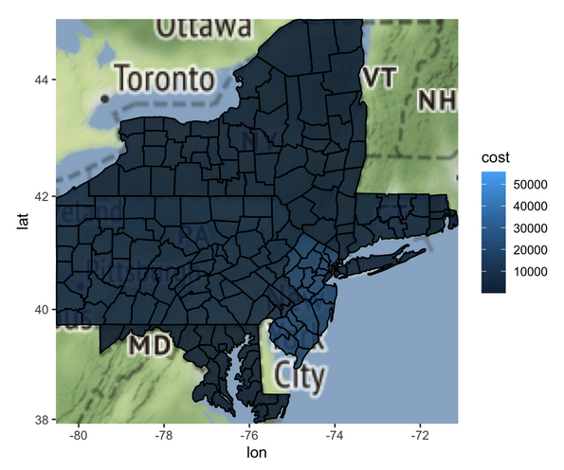
COST BY PLACE
The state with the highest average cost is New York
Maryland has the lowest average cost

Slide 9
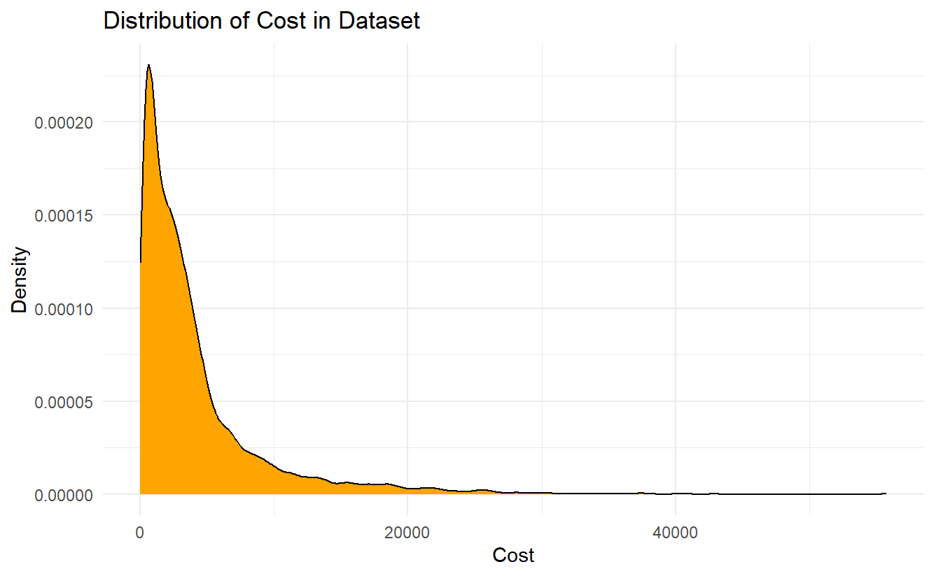
Cost Distribution
Left Skewed with most of the costs under $10,000.
Most people paid about $3,000.

Slide 10
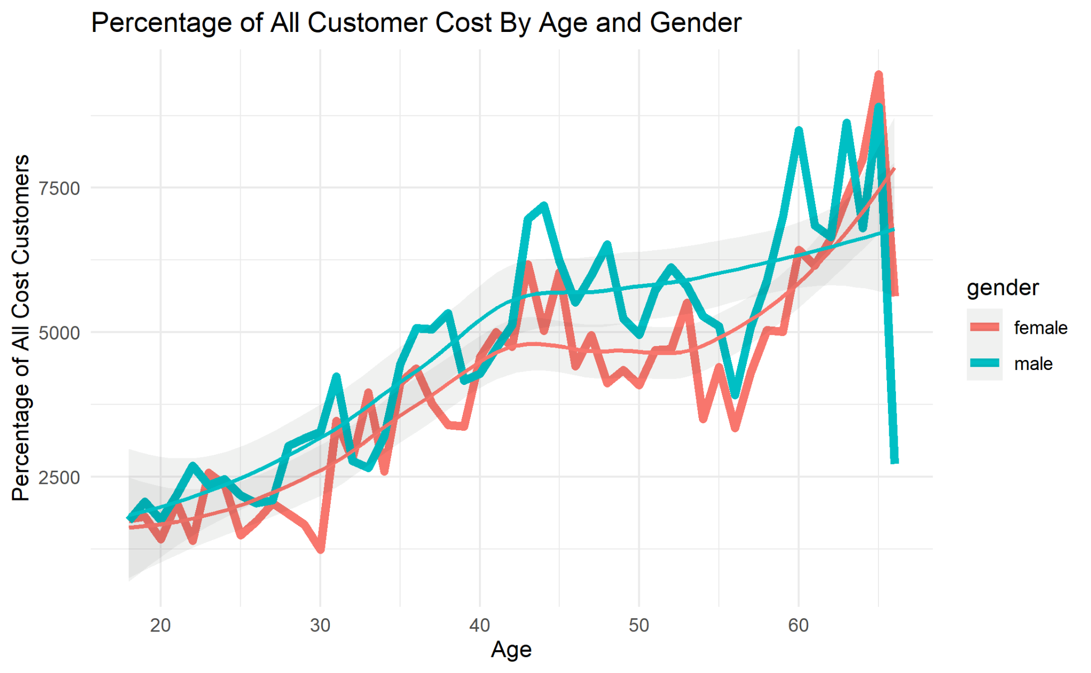
COST BY AGE & GENDER
Generally, you pay less the younger you are.
Males tend to have a higher healthcare cost than females.

Slide 11
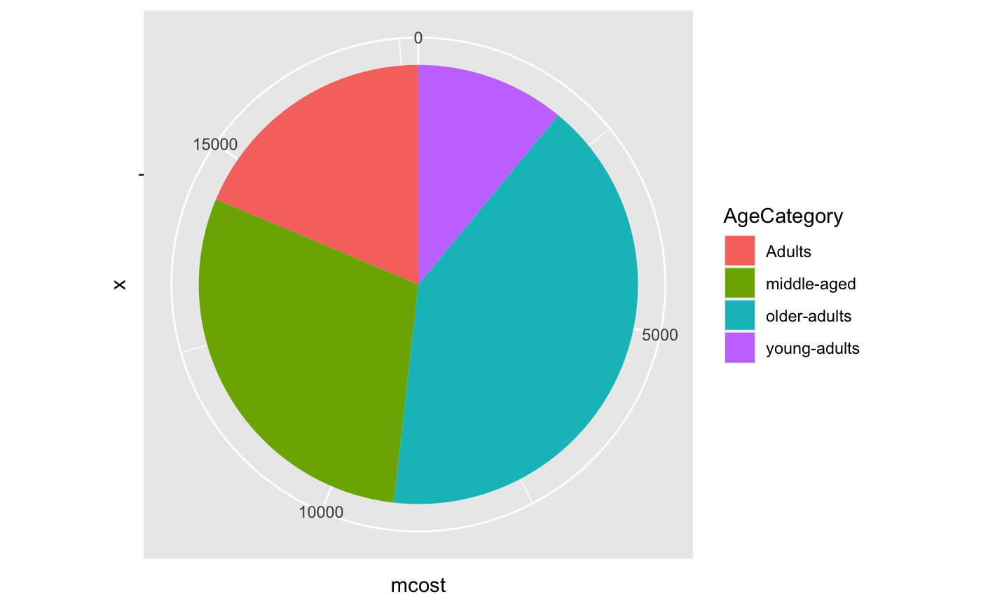
Cost distribution by Age
Age ranges from
18 -25: Young adults
26-40: Adults
41-59: Middle aged
60+ years: Older adults

Slide 12
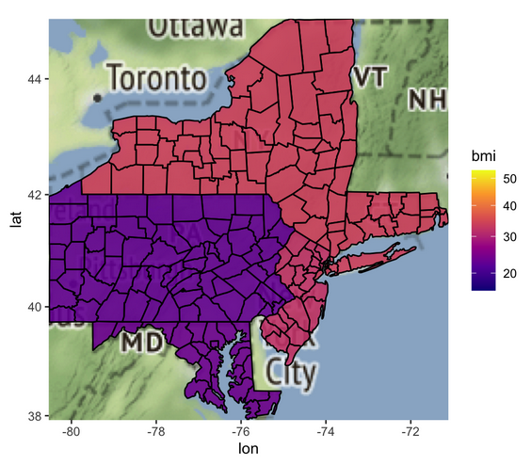
BMI BY PLACE
New York state seems to have the highest average BMI
Maryland has the lowest average BMI

Slide 13
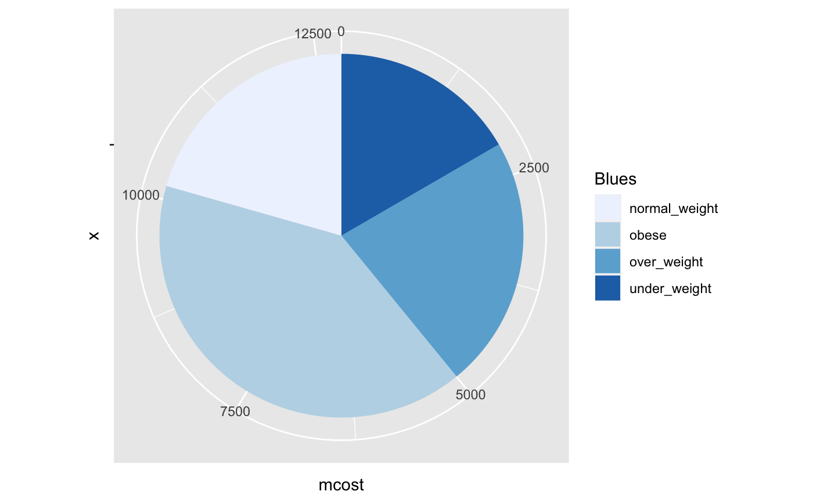
Distribution of BMI by Cost
Normal and overweight people tend to pay a similar average cost with overweight people paying slightly more.
Highest density BMI being around 30

Slide 14
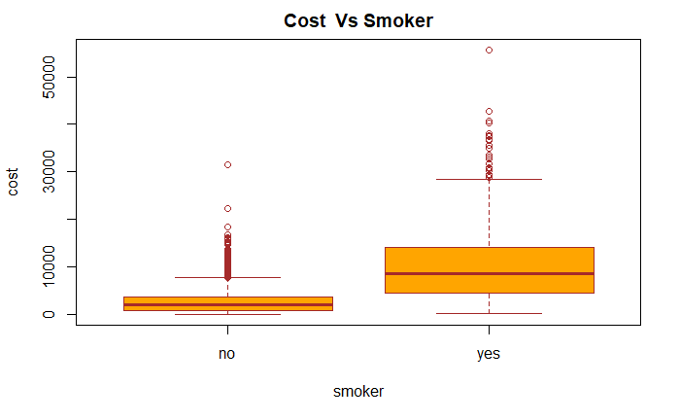
COST BY SMOKER
The median cost for non smokers is lower than smokers.
Non smokers however, have a large amount of outliers suggesting that their costs might be high due to other factors.

Slide 15
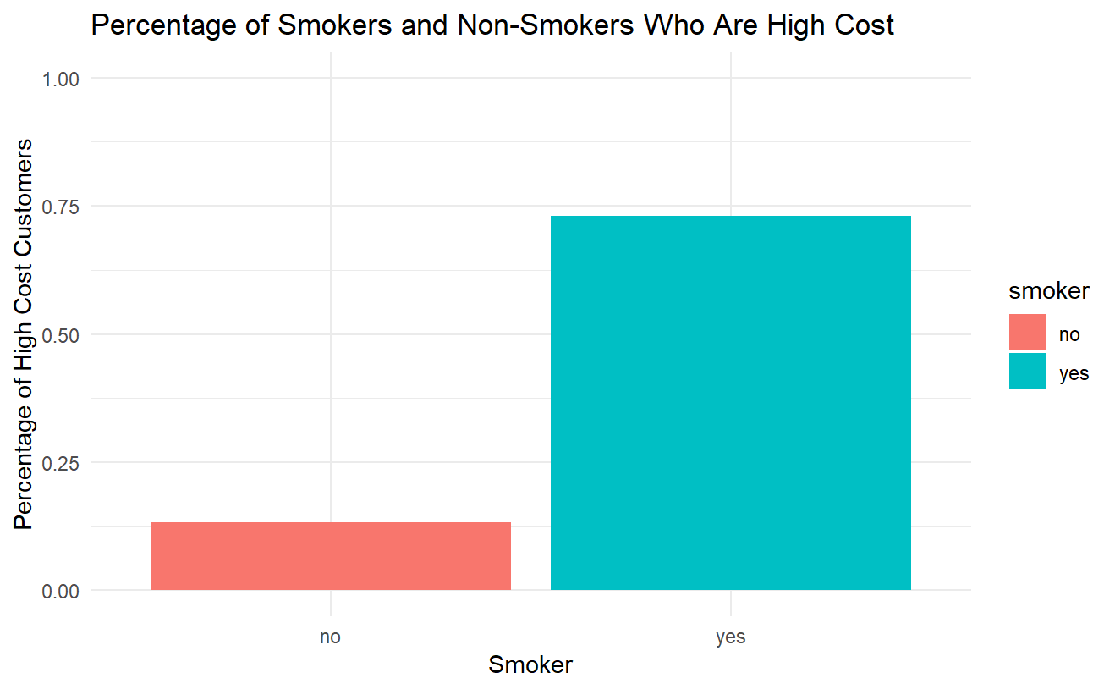
COST BY SMOKER
About 13% of non-smokers were high cost patients
73% of smokers in the data set were high cost patients

Slide 16
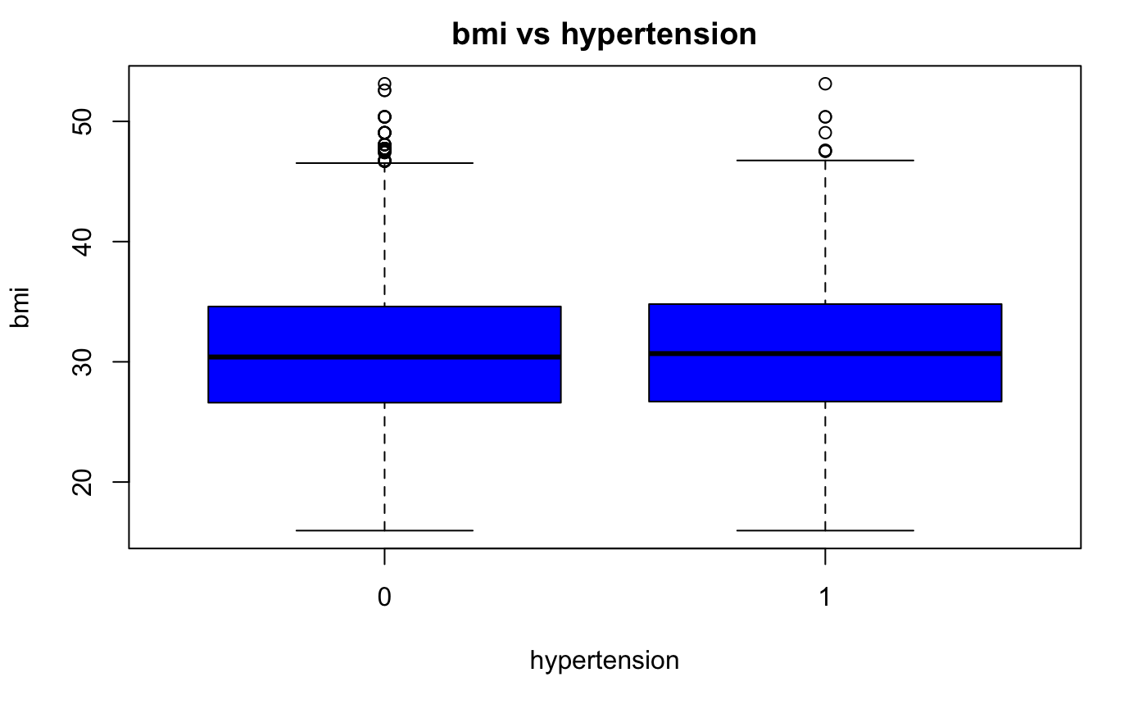
BMI & HYPERTENSION
Clear overlap between bmi and the risk or hypertension

Slide 17
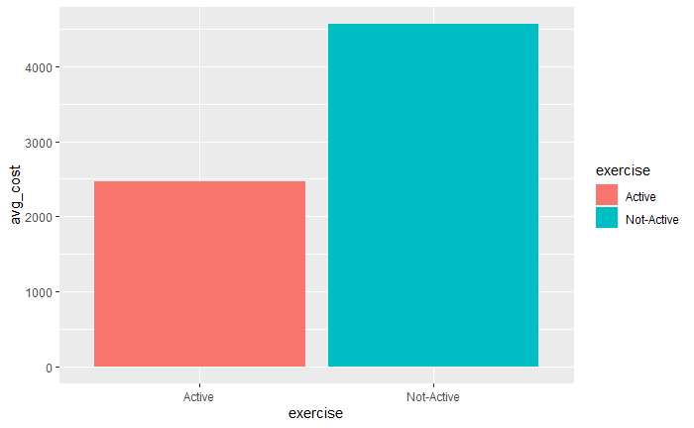
How Active are Customers?
About ⅓ of the customers are active and have an average cost of about $2500
Not active customers tend to pay an average more than $4000 in healthcare

Slide 18
Data Modeling & Trends
03

Slide 19
SIGNIFICANT VARIABLES
Smokers
Exercise
Hypertension
bmi
Age

Slide 20
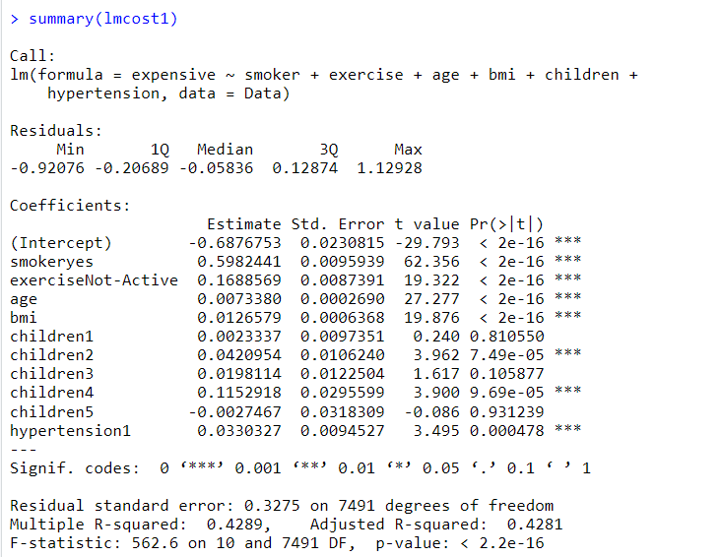
Significant Variables
Important Features
Smoker, exercise, age, bmi , children and hypertension are some of the important variables

Slide 21
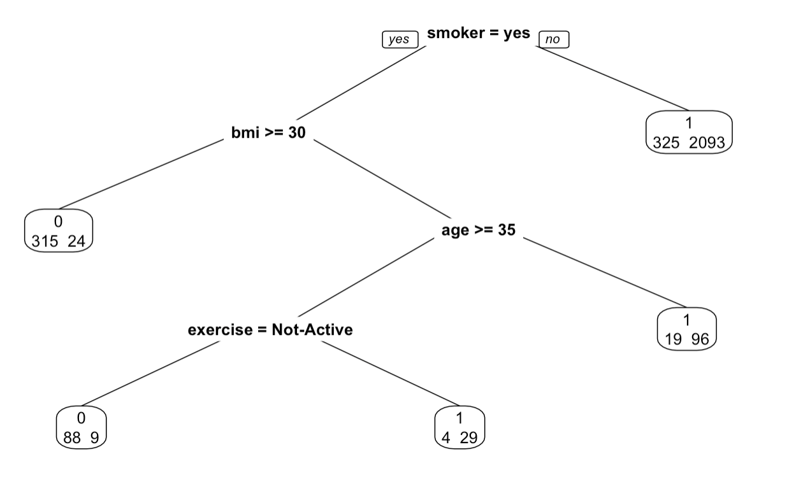
CART
CART TREE GAVE US AN IDEA ABOUT WHICH FEATURES WERE SIGNIFICANT IN PREDICTING WHICH HEALTH CARE MIGHT BE EXPENSIVE.

Slide 22
Analysis of all models
Linear Model
Random Forest Regression
Glm Model
SVM Model
Accuracy = 42.71 %
Accuracy = 88.56%
Accuracy = 87.11%
Accuracy = 87.89%

Slide 23
Association Rules
There is a 91.5 % chance for an individual who is a married male who does not actively exercise , has no hypertension and does get a yearly physical check up to spend more on healthcare.
There is a 51.2 % chance for an individual having 3 children and between the age group 47 - 66 to spend more on healthcare.
There is a 79% chance that an individual living in the state of New York and 76.4 % chance that an individual living in the state of New Jersey is likely to spend more than the other state residents.
There is an 80% chance for an individual having 2 children and and being active smoker to spend more on healthcare.

Slide 24
Conclusion & Recommendation
04

Slide 25
CONCLUSION
Age is a factor in the cost of healthcare because the older you get the more complicated health issues get.
Non-smokers tend not to pay as high of a cost as smokers.
Clear relationship between BMI and hypertension.
Exercising is a great way to keep healthy.

Slide 26
RECOMMENDATIONS
Help young adults cultivate an active lifestyle
This helps them to stay active when they get older to reduce the number of complicated health issues they may face

Slide 27
RECOMMENDATIONS
Invest in campaigns that fight against smoking
Smoking leads to a lot of breathing problems in addition to other organ failure related issues. Providing resources to educate people about smoking and also making rehabilitation easily accessible

Slide 28
THANKS
Do you have any questions?

